Slide 1
Working Of Tim Sort & Its Implementation In Cython

Slide 2
Overview
Why Sorting
What is Tim Sort ?
How does tim sort work ?
how to create a cython module & use in python
Why Cython
Visualization of Tim Sort

Slide 3
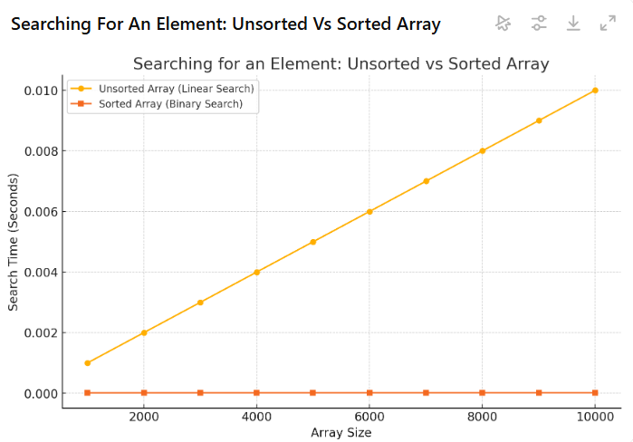
Why SORTING ?
Fundamental operation – organize in specific order
Operations like searching, merging, or data analysis would become highly inefficient.
Searching for an element in an unsorted array has a linear complexity of O(n). But in a sorted array, binary search can reduce this to O(log n)
Real-World Importance:
Online marketplace. Users frequently sort products by criteria like price, rating, or relevance.

Slide 4
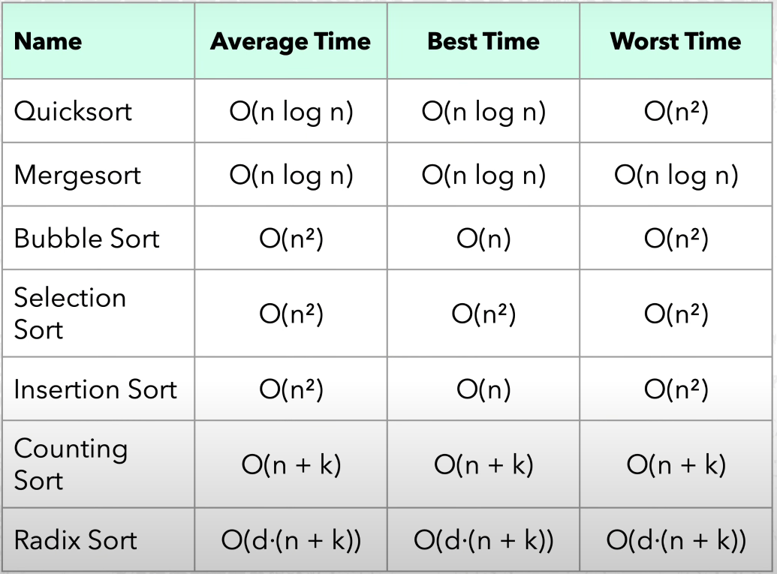
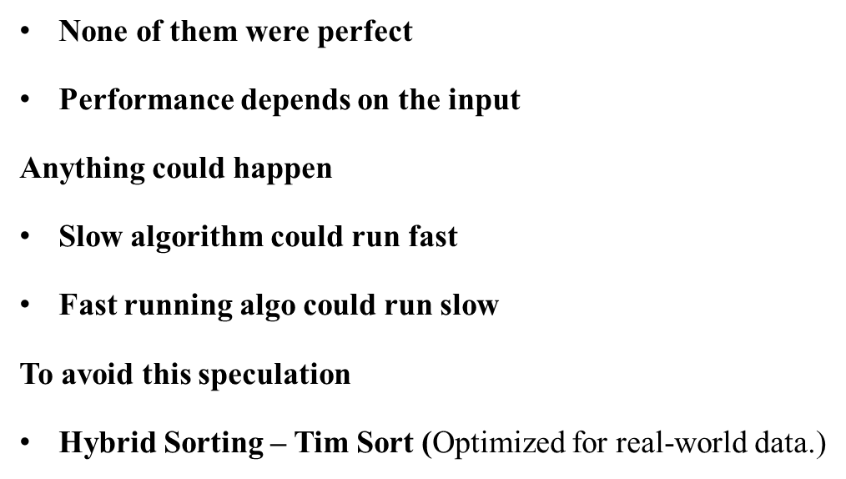
Why Tim Sort?

Slide 5
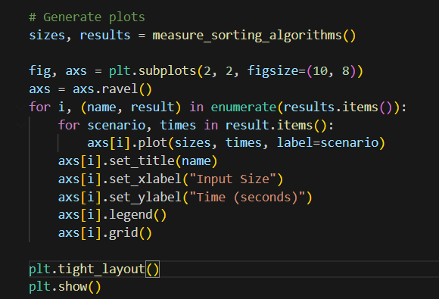
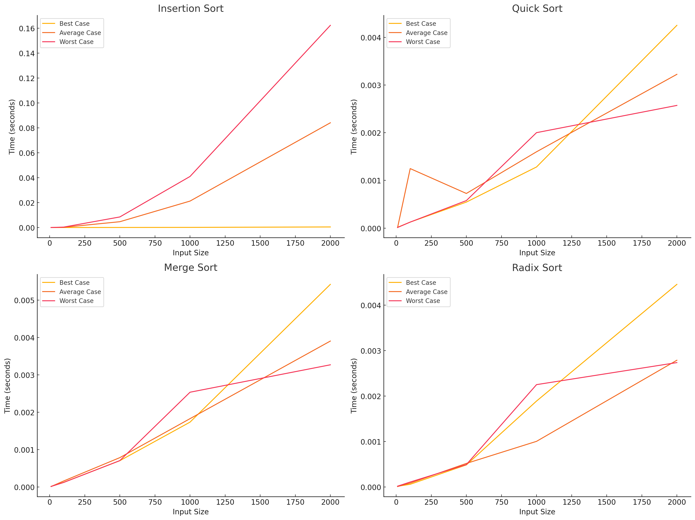

Slide 6
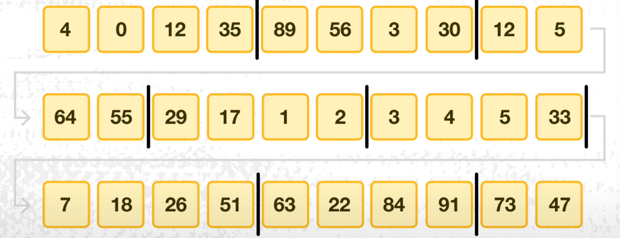
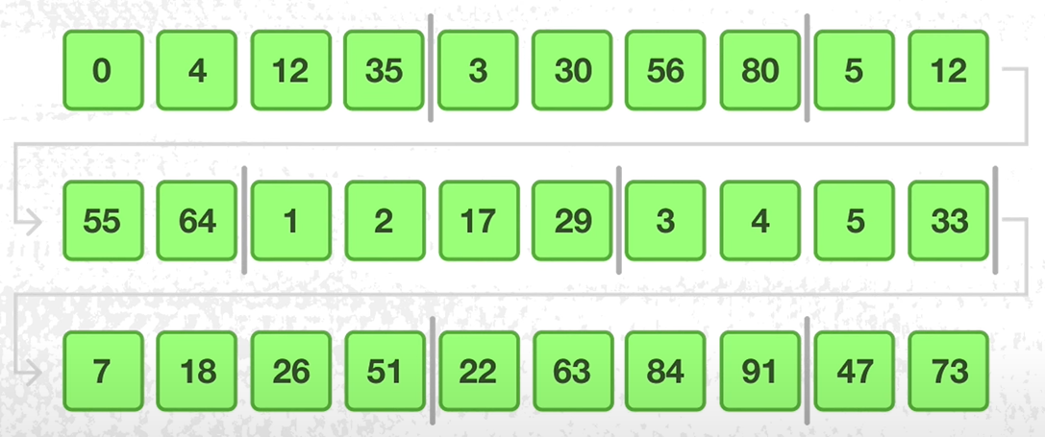
Working Of Tim Sort
Divide The Data Into Small Chunks (Usually 32 or 64)
Sort this chunks using Insertion Sort
Merge the sorted chunks using Smart merging strategy found in Merge sort
Unsorted Array
Sample Run Size = 4
Sorting done Using Insertion

Slide 7
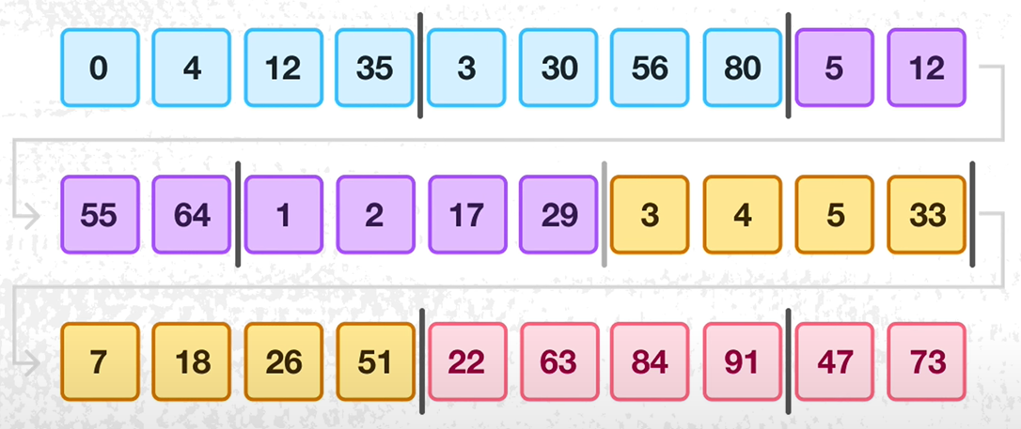
Merging Runs

Slide 8
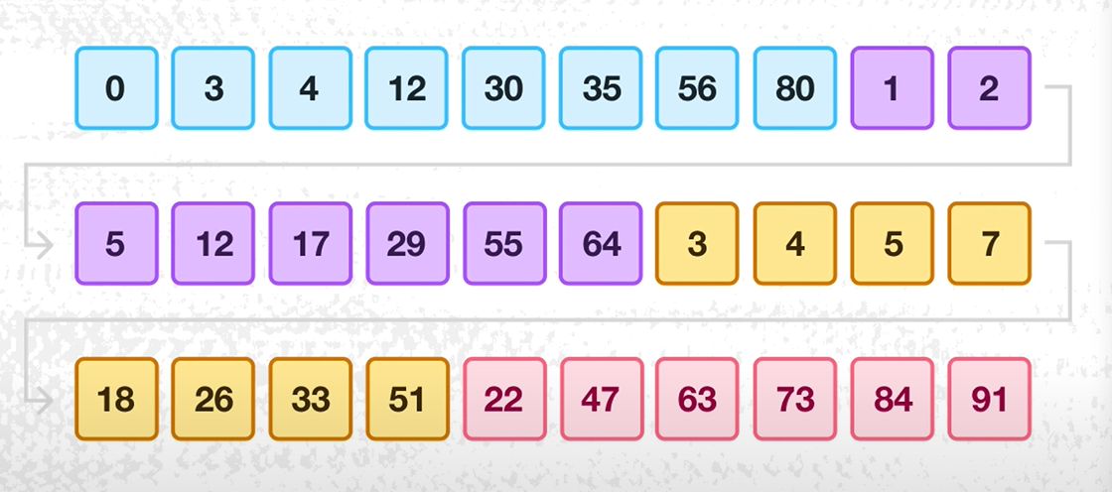
Merging Runs

Slide 9
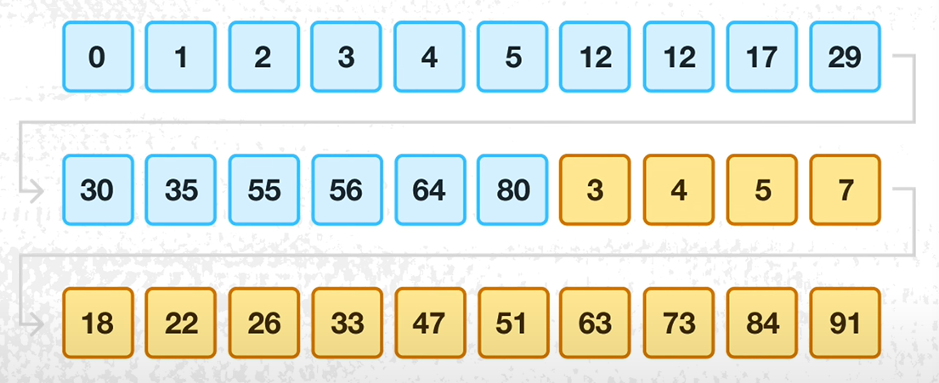
Merging Runs

Slide 10
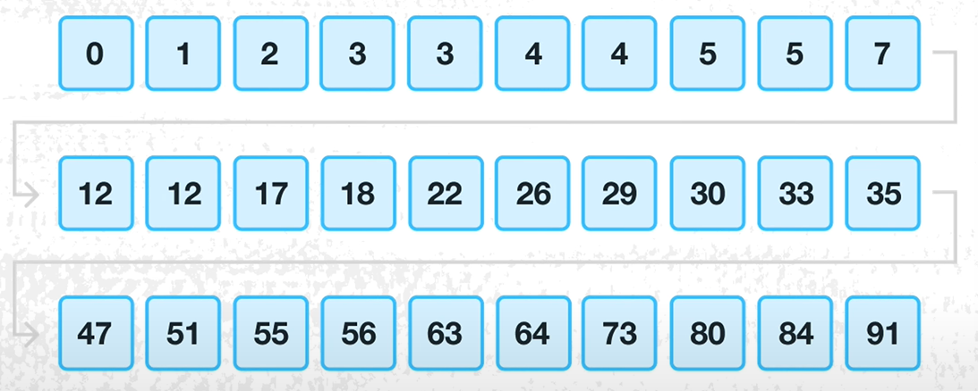
Merging Runs

Slide 11
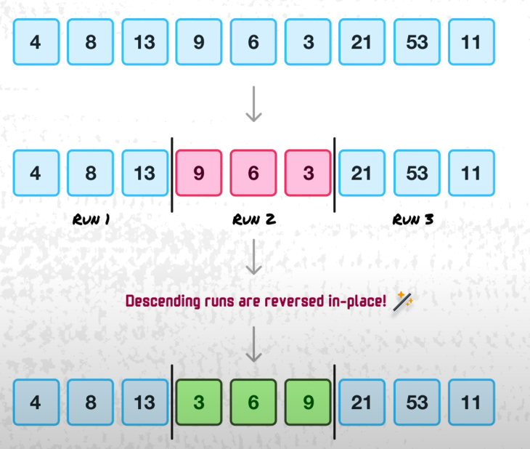
How Insertion Sort Works in Tim
Hybrid Algorithm is only one of the part of Performance
Other Optimization – Detecting the common patterns in our data and Customizing the next Steps.
Optimizing Insertion
When the data is fully reverse sorted (Worst Case)
To overcome – Identify RUNS that are in Reverse order or descending
and perform In-Place reverse on them before sorting or
Merging.

Slide 12
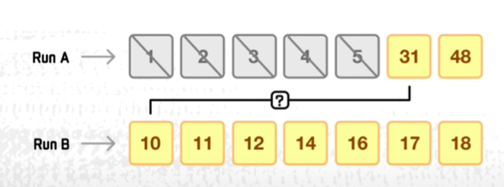
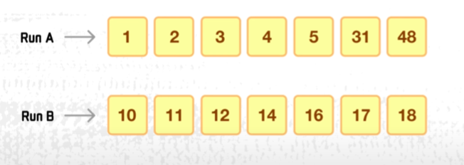
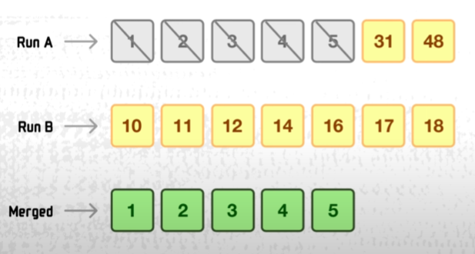
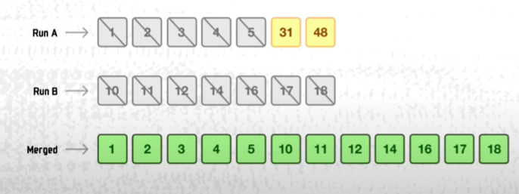
How Merge Works in Tim Sort
Galloping mode/Binary Search Insertion- During merging, if Tim sort observes consecutive elements being chosen from the same run, it switches to galloping mode.
In galloping mode, Tim sort jumps (or "gallops") over multiple elements at a time instead of comparing them one by one.
Reduces the number of comparisons during merging.
Optimizes performance when merging runs that are partially ordered.
As every element In Run B is smaller than Run A[5].
Tim sort adds them all at once to merged collections

Slide 13
Why Cython? For Tim sort
C-style static typing - variables, loops, and functions, reducing runtime checks and memory allocation overhead.
Memory view for Efficient Slicing –memoryviews in Cython allows slicing arrays without creating copies, saving memory and speeding up data access.
Parallelism Support-Cython supports OpenMP for multi-threading, i.e. to parallelize merging steps in TimSort utilizing multiple CPU cores for speedup. Improves performance of Python programs
Compatible with Python libraries and frameworks & Integrates seamlessly with Python modules.

Slide 14
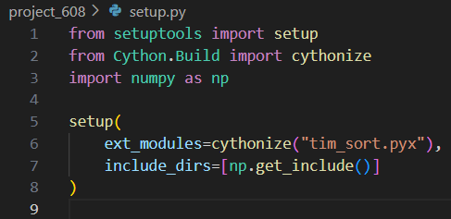
Steps to Compile, Import, and Run a Cython File
Install
Required Python (version 3.6 or higher)
pip install cython
install mingw32
Create a Cython File & setup file
Save as .pyx file extension (tim_sort.pyx)
Create a Setup.py file
cythonize: Compiles the Cython .pyx file into a C extension module.
include_dirs: Ensures compatibility with NumPy As we are using memoryviews.

Slide 15
Steps to Compile, Import, and Run a Cython File
Compile the Cython File
Run the setup.py file to compile
Command
python setup.py build_ext –inplace
(Converts .pyx file .c file)
Import the Compiled
from tim_sort_cython import timSort
Run
python tim_sort.py

Slide 16
Thank you
Tabrez Ahammed

